Slide 1


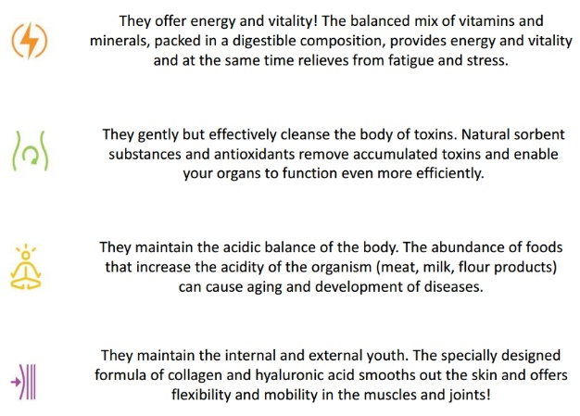
Abut Deta Elis Holding
DeLixir Supplements
The DETA ELIS HOLDING group is a certified and recognized group of companies, activated in manufacturing and promoting electronic wellness devices, based on the principles of Bioresonance, but it also offers educational services related to the technology that applies to these specific products (Bioresonance therapy).
The beginning of the course of the company was the construction of the first bioresonance devices aimed at health professionals in 1992, at Zelenogkrant of Russia under the name «ELIS».
1998 was the year that marked a major technological step forward for the company, by the manufacture of the diagnostic device «Deta – Professional», which was patented.
In 1998 Russia’s Health Ministry granted permission to the company to conduct medical examinations in public hospitals with this specific device.
After twenty years of scientific research, portable bioresonance devices have been manufactured, which are worldwide patented.
How it works
The company, based on the great technological breakthrough of the mobile devices and under the inspired leadership of the founders, Konopliova Tatiana and Roman Novikov, chose the network marketing as the way to promote the devices, transferred its headquarters in Fulda, Germany, and renamed the company as DETA ELIS HOLDING.
The faceted and constantly renewed our training is provided by experienced and reputable places to much instructors and designed to lead to financial independence and personal self-development.
Finally, our innovative devices designed to restore physical health and wellbeing.
Innovations of DETA result twenty years of research conducted by Russian scientists and specialists. Were in leading clinics, hospitals and universities of the Russian Federation.
Tell: 0227749309 & +201023633302
www.detaelisegypt.com/

Slide 2




Deta Elis Egypt Independent Partners Deta Elis.
We are unique distributors of products and devices Deta Elis Holding in the Egypt and African continent.
DETA ELIS EGYPT
Tell: 0227749309 & +201023633302
info4u@detaelisegypt.com
www.detaelisegypt.com/

